Slide 1
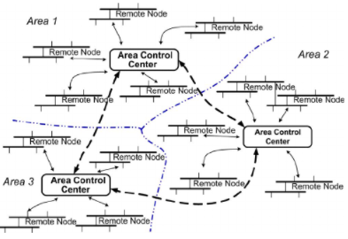
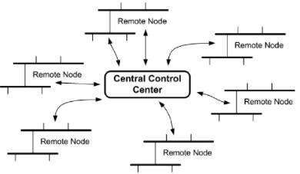
Manipulator control
Decentralized control strategy
Centralized control strategy
Each distributed energy source works freely utilizing measured local signals
No source is the reference, and all sources are at a solitary
Requires all resources to be dispatchable
The centralized controller is responsible for managing the execution of other components
All sources are dependent to each other
Fig.1
Fig.2
Notes:
Notes: Introducing presenter, why DCS and CCS, what is DCS and CCS, relationship and difference, explanation about figures and connection to text
Reference: An overview of control techniques and technical challenge for inverters in micro grid, Natarajan Prabaharan, Hybrid-Renewable Energy Systems in Microgrids, 2018
https://ifs.host.cs.st-andrews.ac.uk/Books/SE9/Web/Architecture/ArchPatterns/CentralControl.html, Ian Sommerville 2008
https://www.researchgate.net/publication/224205518_Comparison_Between_Communication_Infrastructures_of_Centralized_and_Decentralized_Wide_Area_Measurement_Systems, Comparison Between Communication Infrastructures of Centralized and Decentralized Wide area measurement systems

Slide 2
Notes
Introducing presenter
Why talking about decentralized and centralized control strategy
What is decentralized and centralized control strategy
Relationship and difference
Explanation about figures and connection to text

Slide 3
Reference
An overview of control techniques and technical challenge for inverters in micro grid, Natarajan Prabaharan, Hybrid-Renewable Energy Systems in Microgrids, 2018
https://ifs.host.cs.st-andrews.ac.uk/Books/SE9/Web/Architecture/ArchPatterns/CentralControl.html
Ian Sommerville 2008
https://www.researchgate.net/publication/224205518_Comparison_Between_Communication_Infrastructures_of_Centralized_and_Decentralized_Wide_Area_Measurement_Systems
Comparison Between Communication Infrastructures of Centralized and Decentralized Wide area measurement systems

